Slide 1
Advancing InfoSec Towards an Open, Shareable, Contributor-Friendly model of speeding InfoSec learning
John Lambert, @JohnLaTwC
Microsoft Threat Intelligence Center

Slide 2


Conventional Wisdom in Defense
Traditional Defenders
Defend a list of assets
Manage incidents
Minimize risks by keeping incidents secret
View pentest results as a report card
Think about stopping attacks
 | Modern Defenders
 | Defend a graph of assets
 | Manage adversaries
 | Maximize learning by sharing incidents with trusted outside peers
 | View pentest results as an input
 | They think about increasing attacker requirements

Slide 3
How do we increase the rate of learning in InfoSec?

Slide 4
If you want to go fast, go alone If you want to go far, go together African Proverb

Slide 5
Advancing InfoSec

Slide 6
Accelerating Learning in InfoSec
Executable Know-how
Organized Knowledge
Repeatable Analysis
Promoting Community

Slide 7
Organized Knowledge

Slide 8
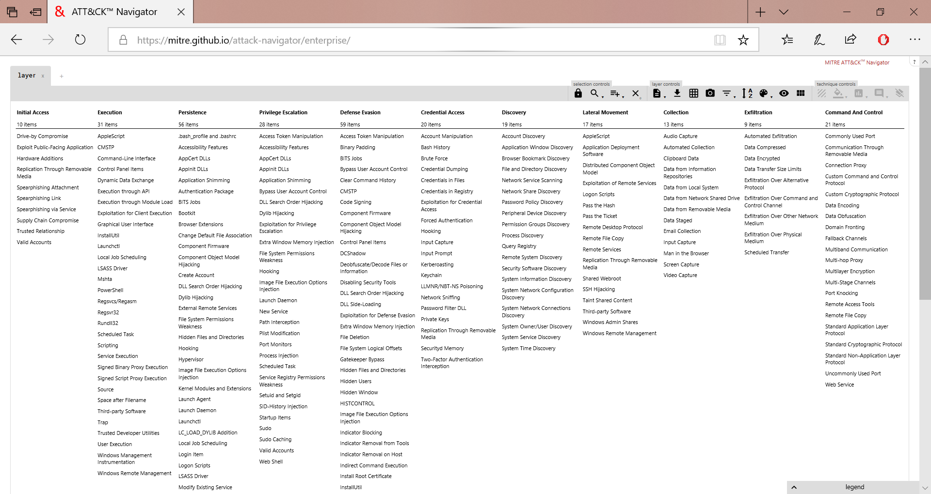
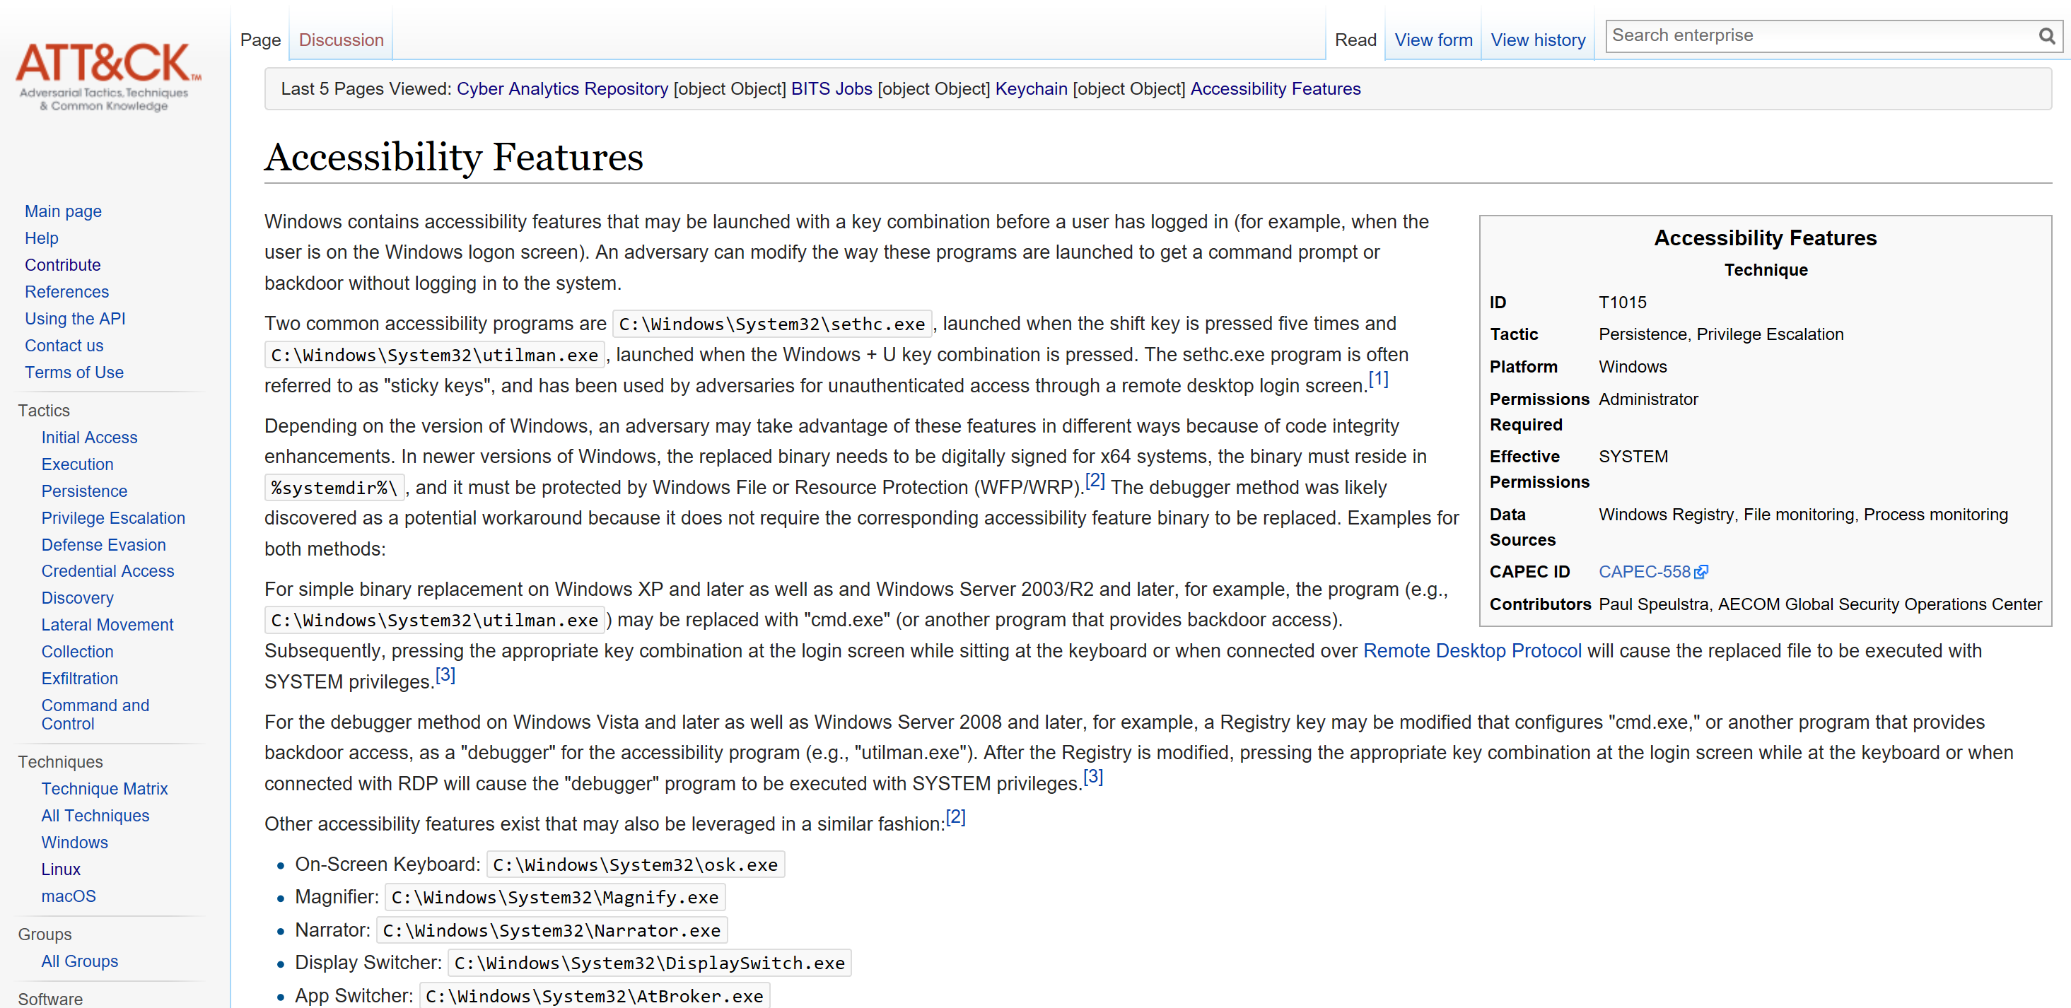
Knowledge

Slide 9
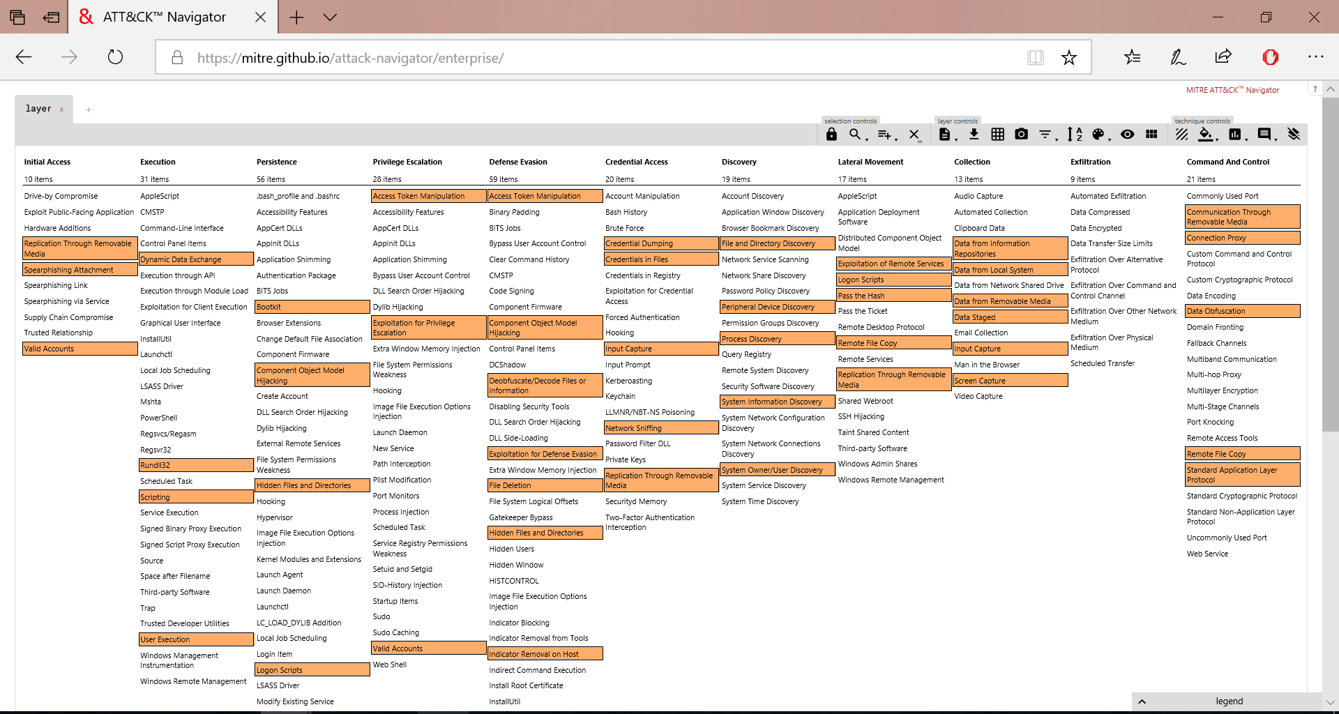
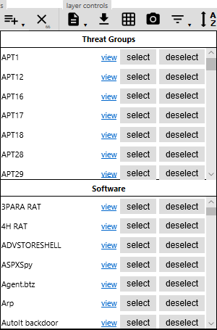

Slide 10
Activity Groups
H
hydrogen
1
He
helium
2
Li
lithium
3
Be
beryllium
4
B
boron
5
C
carbon
6
N
nitrogen
7
O
oxygen
8
F
fluorine
9
Ne
neon
10
Over 110 groups known to us
Over 70 full-fledged Activity Groups
Na
sodium
11
Mg
magnesium
12
Al
aluminium
13
Si
silicon
14
15
P
phosphorous
S
sulphur
16
Cl
chlorine
17
Ar
argon
18
K
potassium
19
Ca
calcium
20
Sc
scandium
21
Ti
titanium
22
V
vanadium
23
Cr
chromium
24
Mn
manganese
25
Fe
iron
26
Co
cobalt
27
Ni
nickel
28
Cu
copper
29
Zn
zinc
30
Ga
galium
31
Ge
geramanium
32
33
As
arsenic
Se
selenium
34
Br
bromine
35
Kr
krypton
36
Rb
rubidium
37
Sr
strontium
38
Y
yttrium
39
Zr
zirconium
40
Nb
niobium
41
Mo
molybdenum
42
Tc
technetium
43
Ru
ruthenium
44
Rh
rhodium
45
Pd
palladium
46
Ag
silver
47
Cd
cadminium
48
In
indium
49
Sn
tin
50
51
Sb
antimoney
Te
tellurium
52
I
iodine
53
Xe
xenon
54
Cs
caesium
55
Ba
barium
56
Hf
hafnium
72
Ta
tantalum
73
W
tungsten
74
Re
rhenium
74
Os
osminium
76
Ir
iridium
77
Pt
platinum
78
Au
gold
79
Hg
mercury
80
Tl
thallium
81
Pb
lead
82
83
Bi
bismuth
Po
polonium
84
At
astatine
85
Rn
radon
86
Rf
rutherfordium
112
104
Db
dubnium
105
Sg
seaborgium
106
Bh
bohrium
107
Hs
hassium
108
Mt
meitnerium
109
Ds
darmstadtium
110
Rg
goentgenium
111
Cn
copernicium
Nh
nihonium
113
Fl
flerovium
114
Mc
moscovium
115
Lv
livermorium
116
117
Ts
tennessine
Og
oganesson
Fr
francium
118
Fr
francium
87
Ra
radium
Ra
radium
88
La
lanthanum
57
Ce
cerium
58
Pr
praseodymium
59
Nd
neodymium
60
Pm
promethium
61
Sm
samarium
62
Eu
europium
63
Gd
gadolinium
64
Tb
terbium
65
Dy
dysprosium
66
Ho
holmium
67
Er
erbium
68
Tm
thulium
69
Yb
ytterbium
70
Lu
lutetium
71
Ac
actinium
89
Th
thorium
90
Pa
protactinium
91
U
uranium
92
Np
neptunium
93
Pu
plutonium
94
Am
americium
95
Cm
curium
96
Bk
berkelium
97
Cf
californium
98
Es
einsteinium
99
Fm
fermium
100
Md
mendelevium
101
No
nobelium
102
Lr
lawrencium
103

Slide 11
Knowledge
What about Cloud?

Slide 12
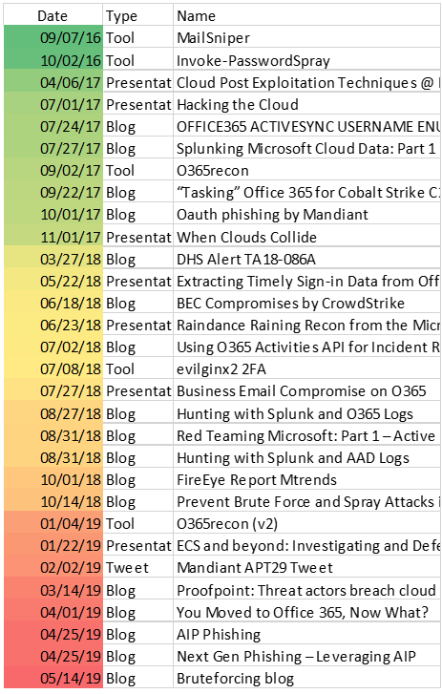
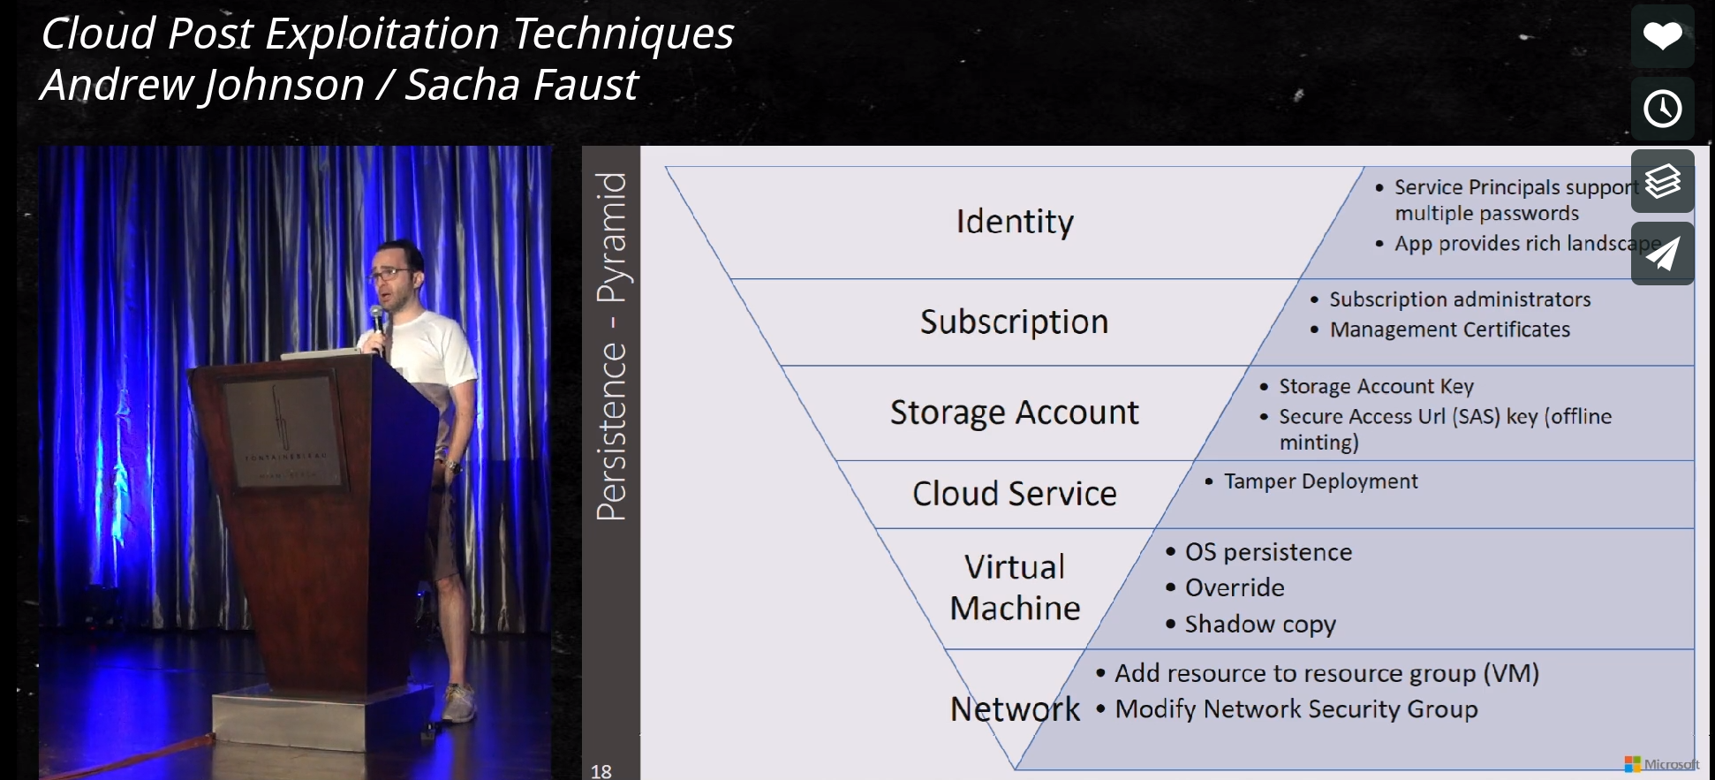
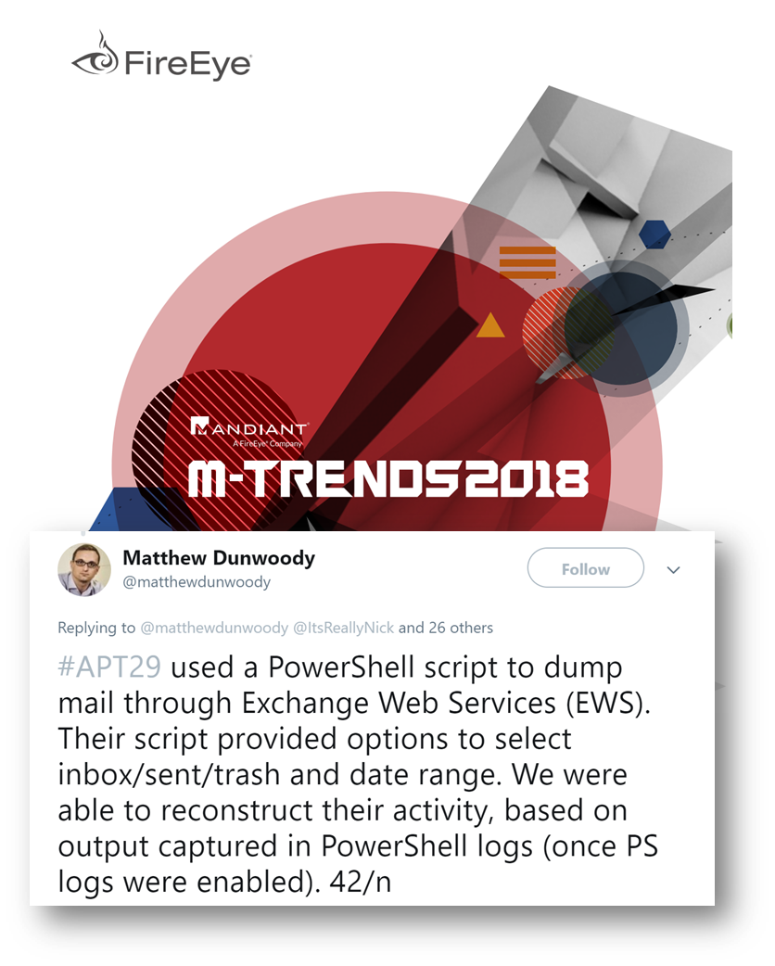
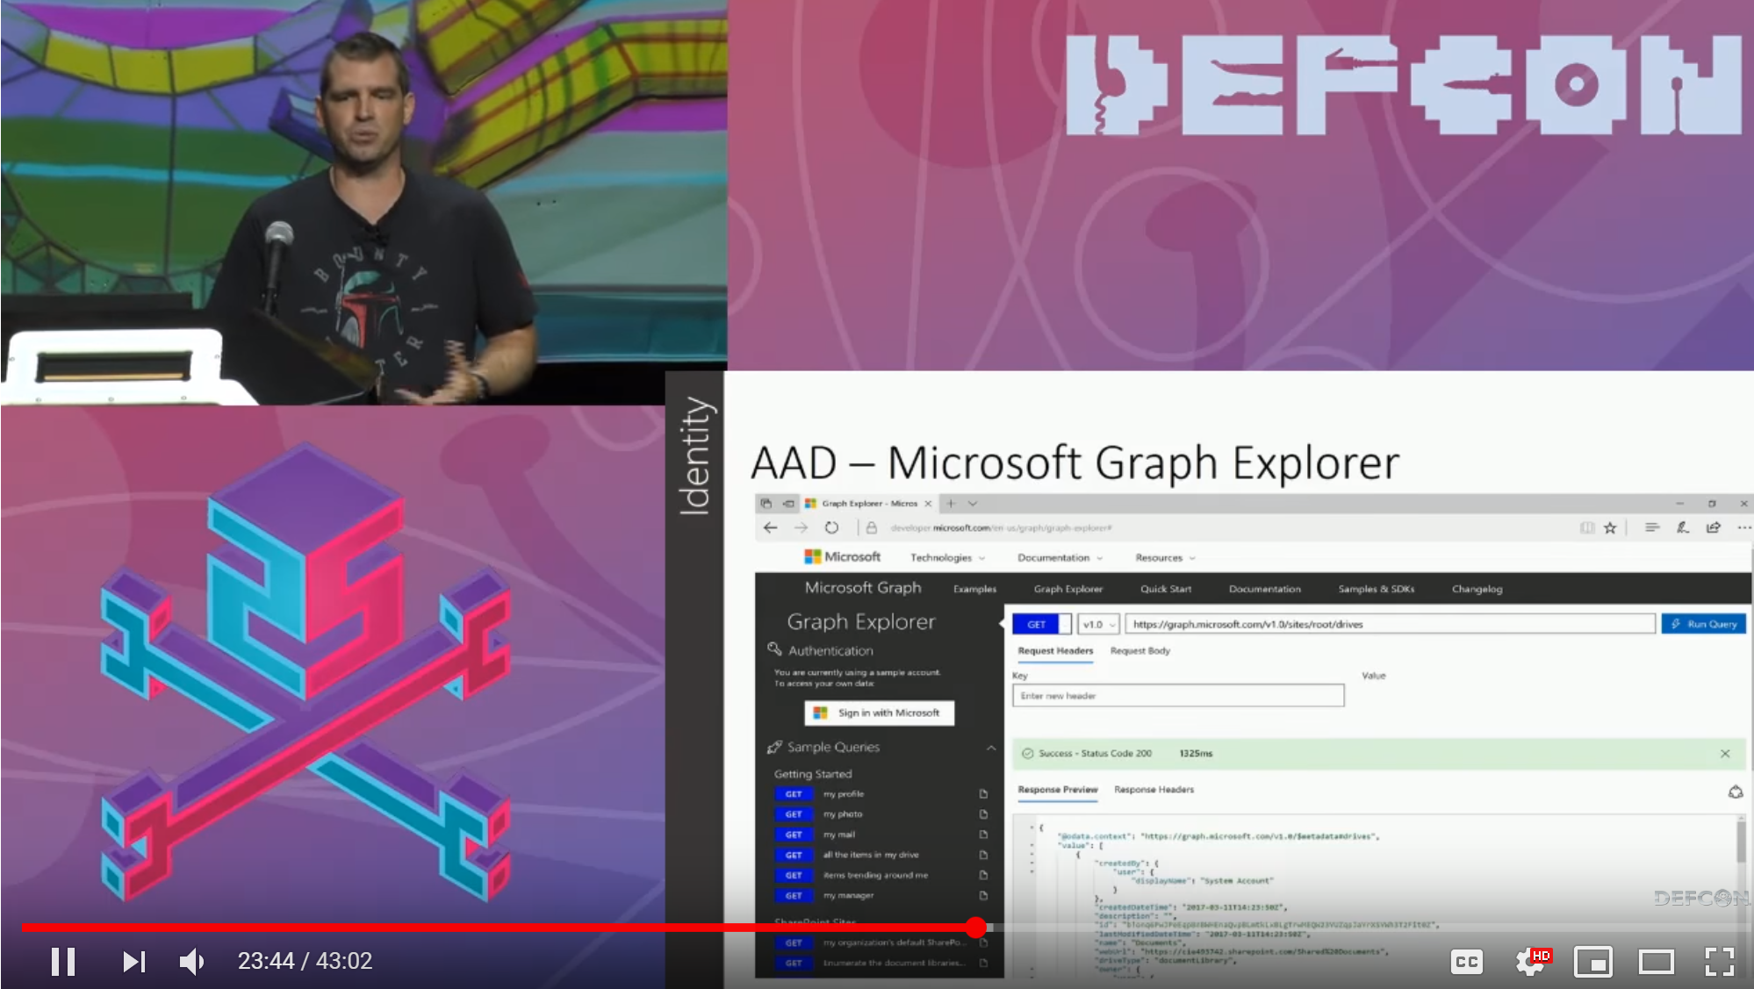
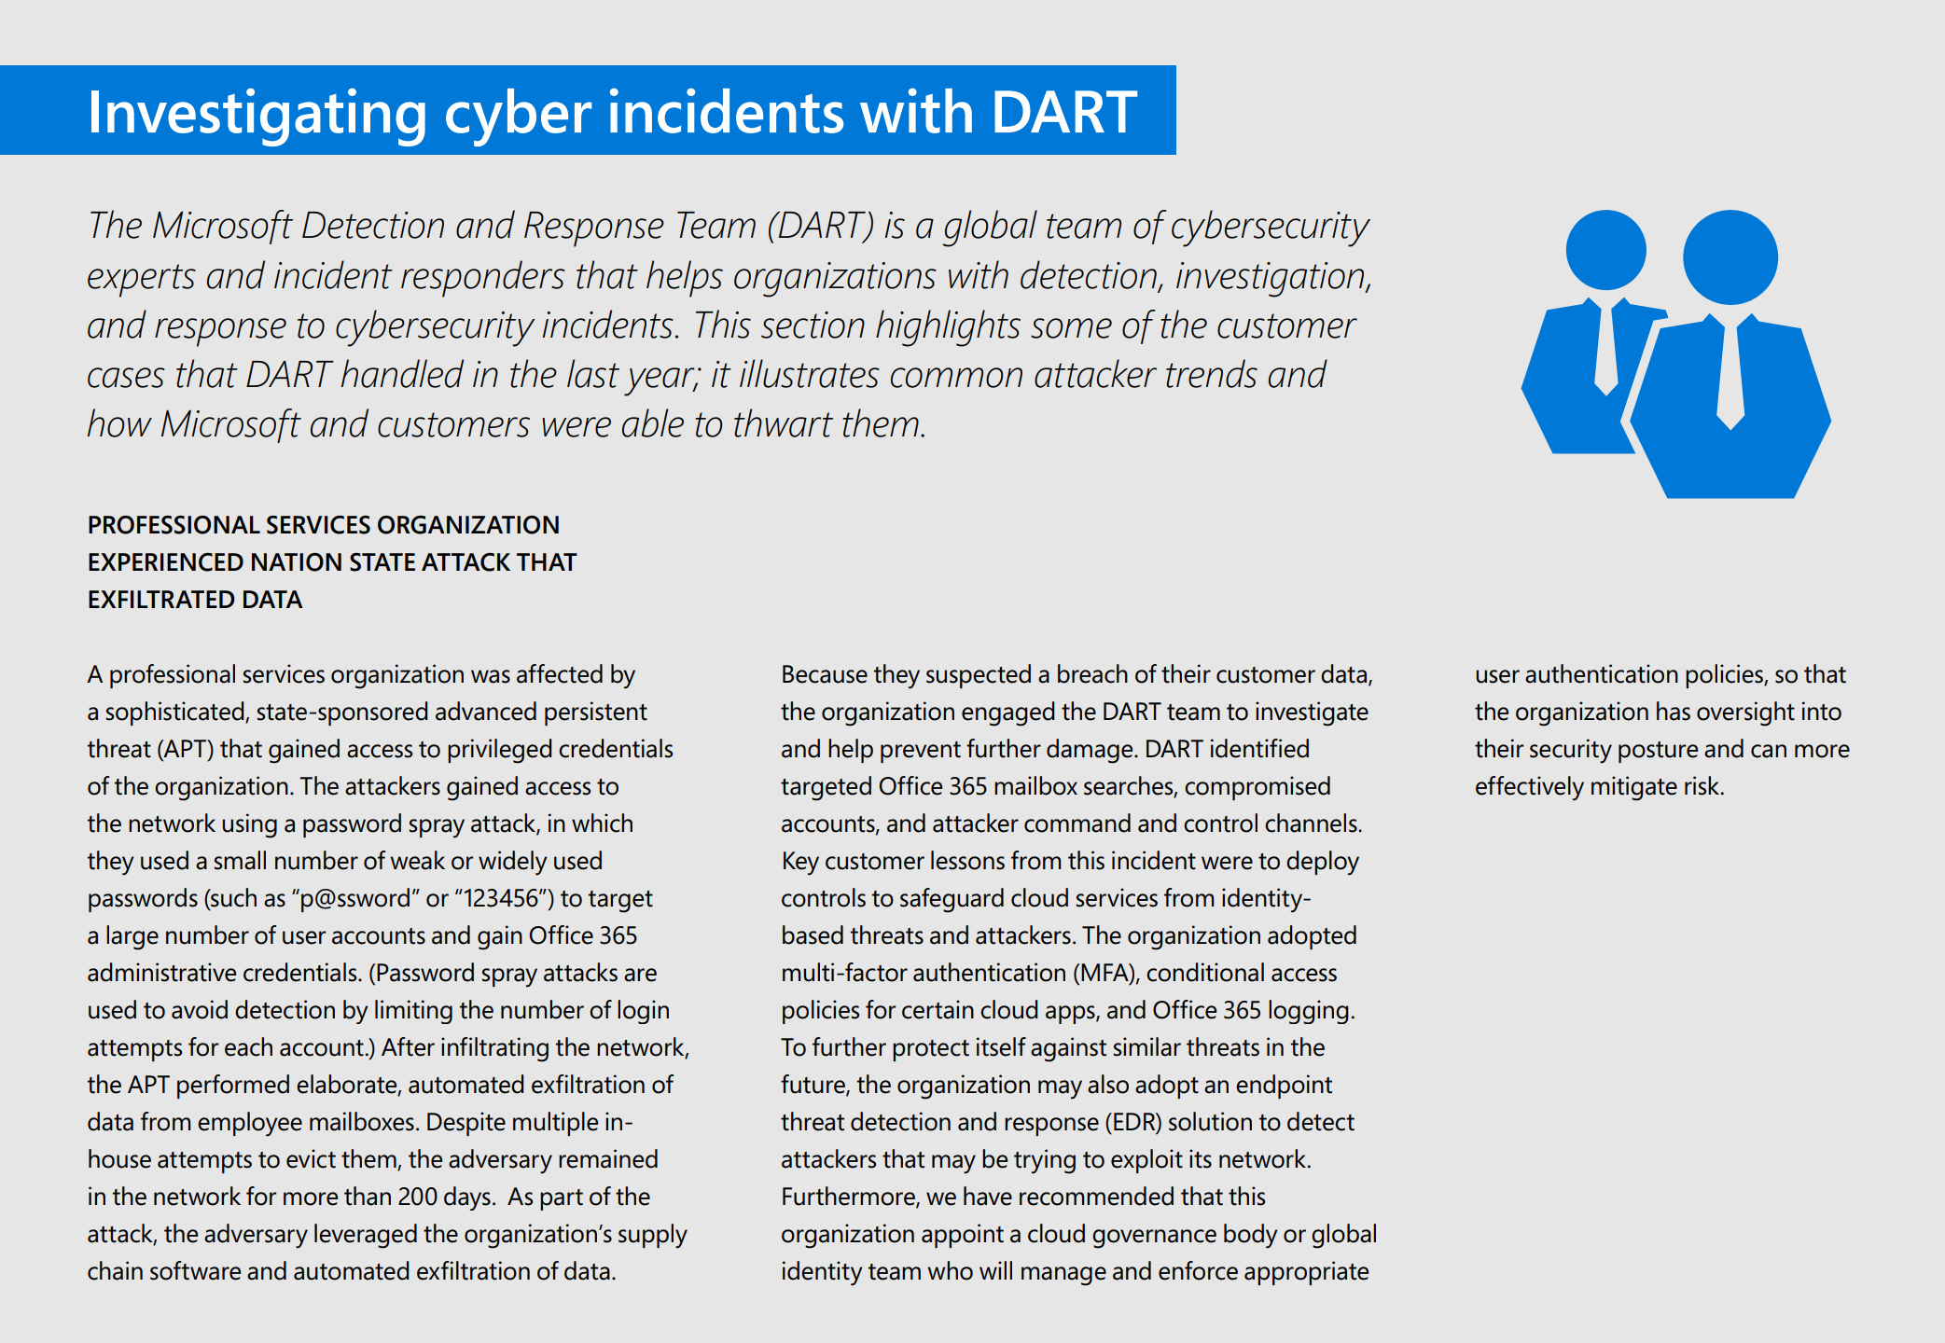
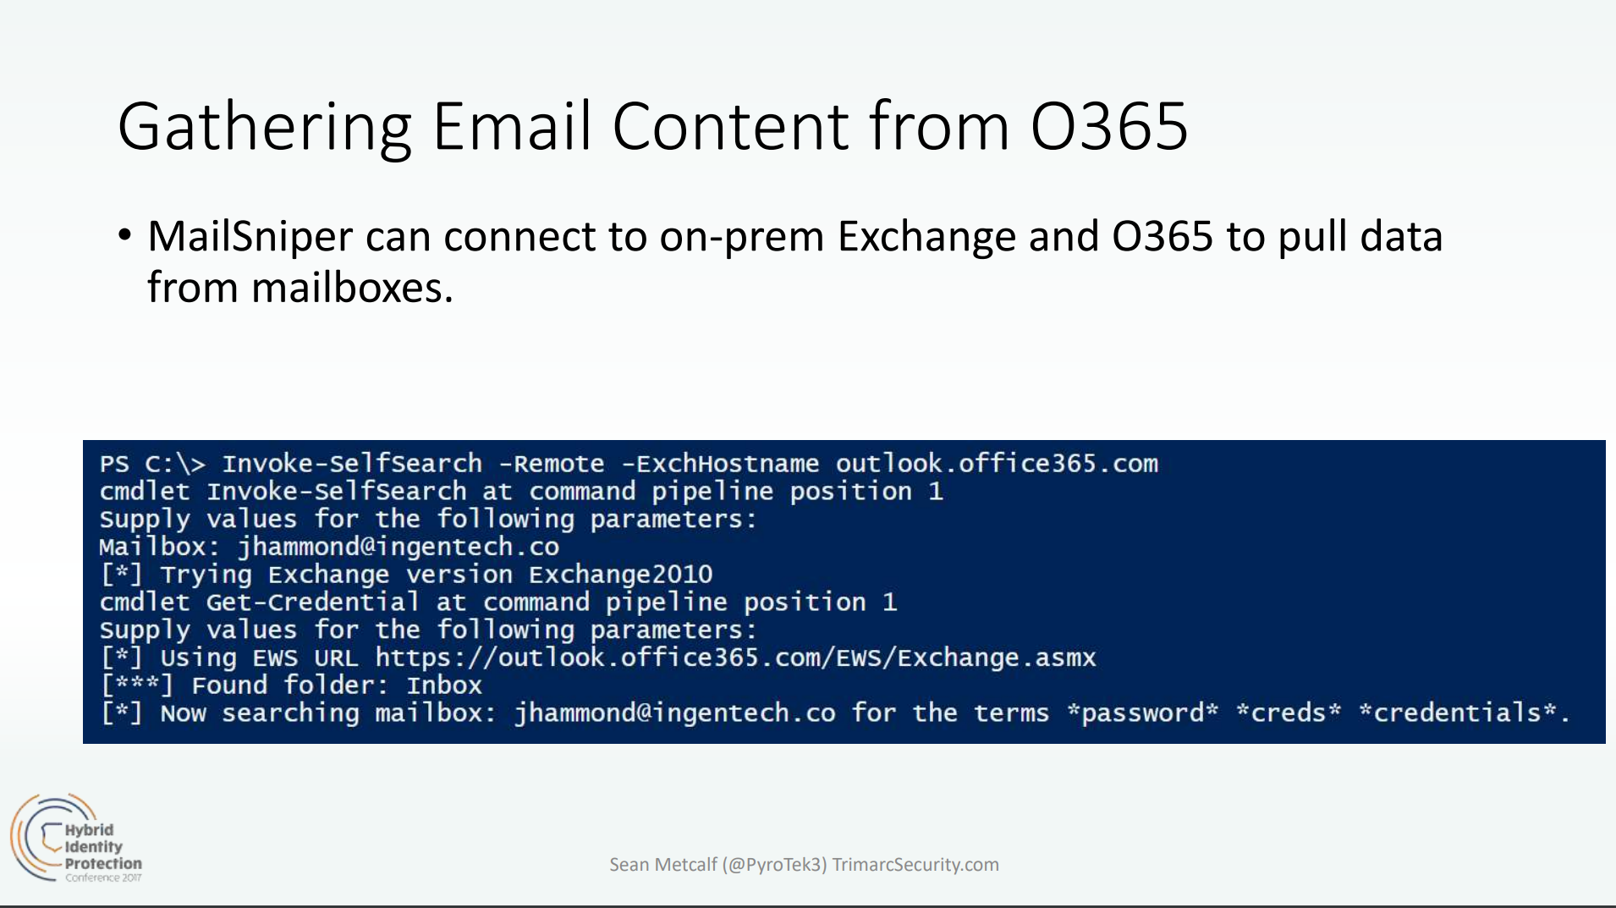
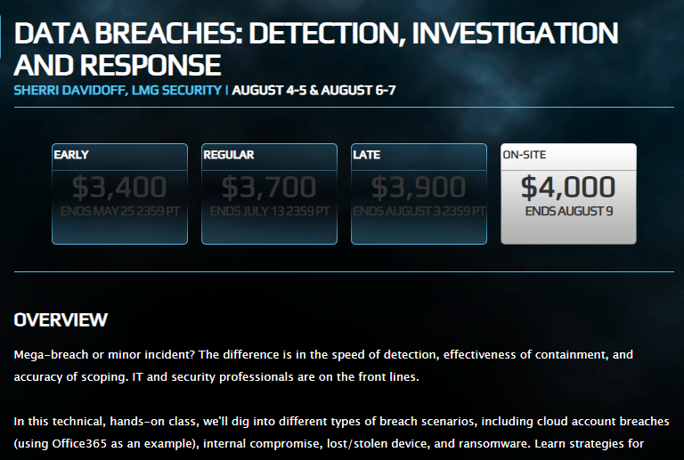

Researcher Interest in O365 Increasing
Presentations and Tools
Attacks
Cloud Post Exploitation Techniques @ Infiltrate 2017
“DEF CON 25 (2017) – Hacking the Cloud
Security in a Cloud-Enabled Environment
Blackhat 2018 Training
B-Sides 2019

Slide 13
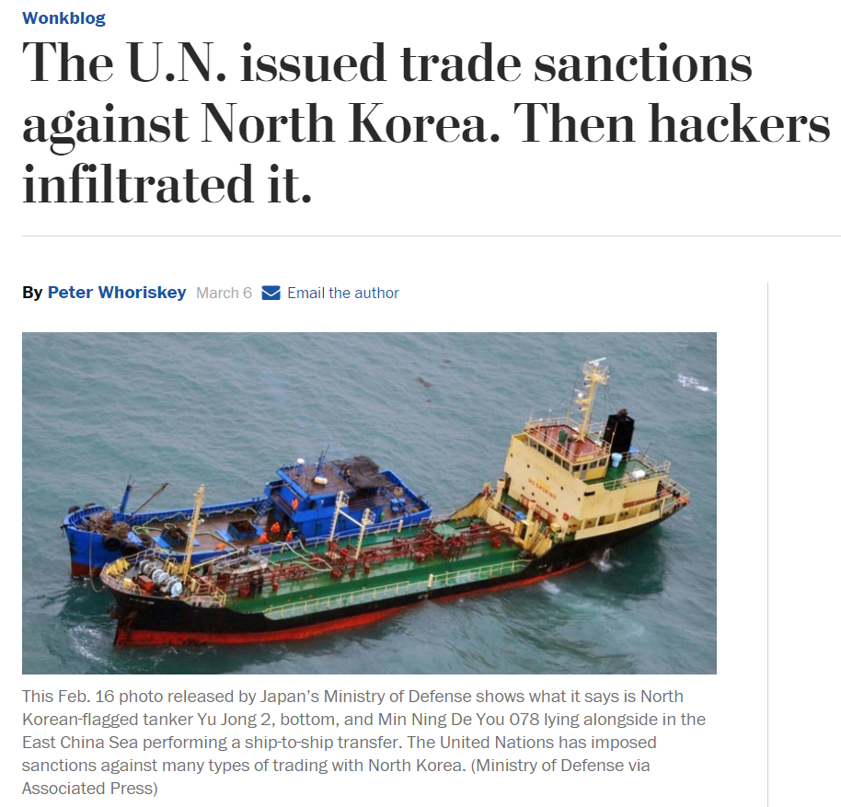
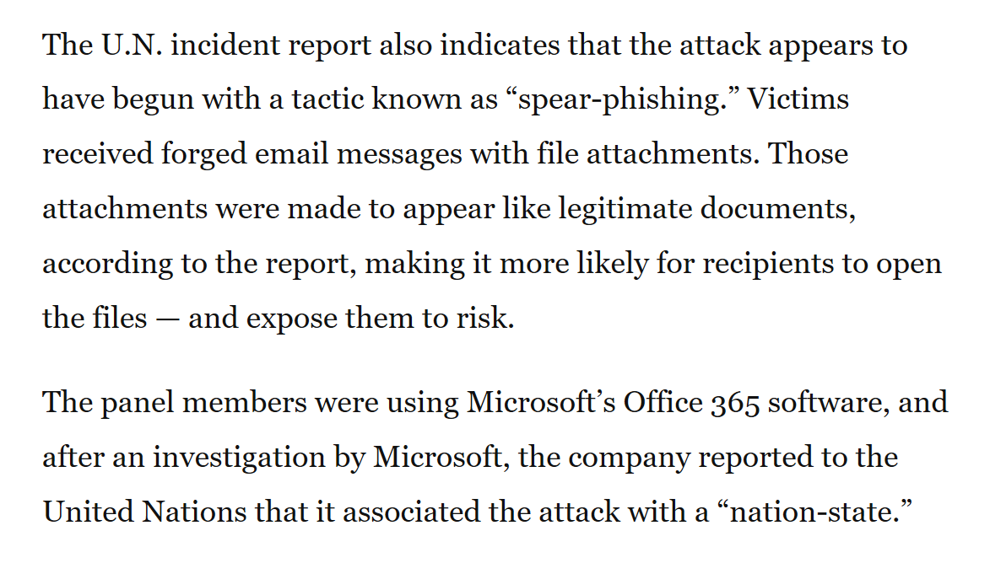
Credential Attacks - THALLIUM

Slide 14
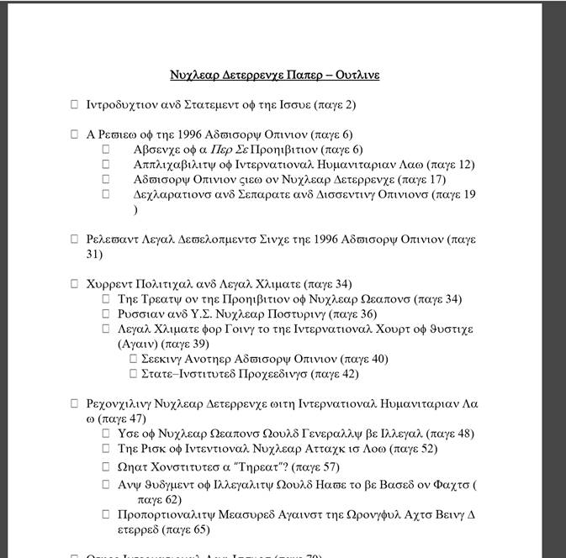
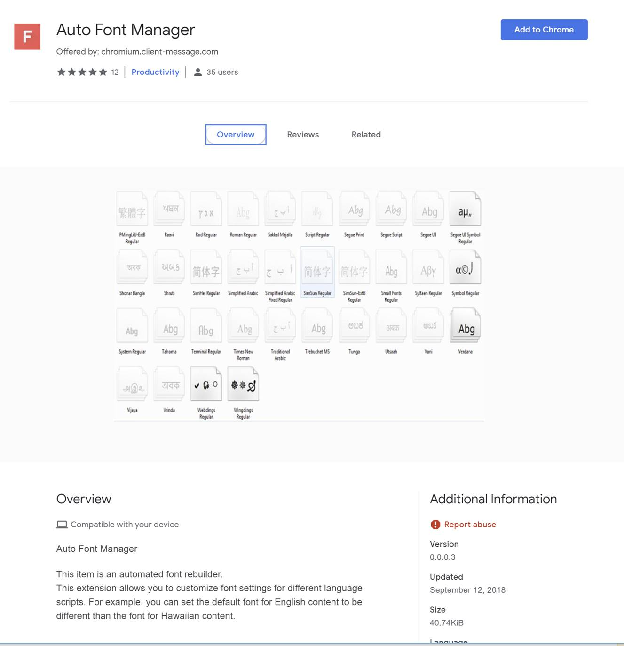
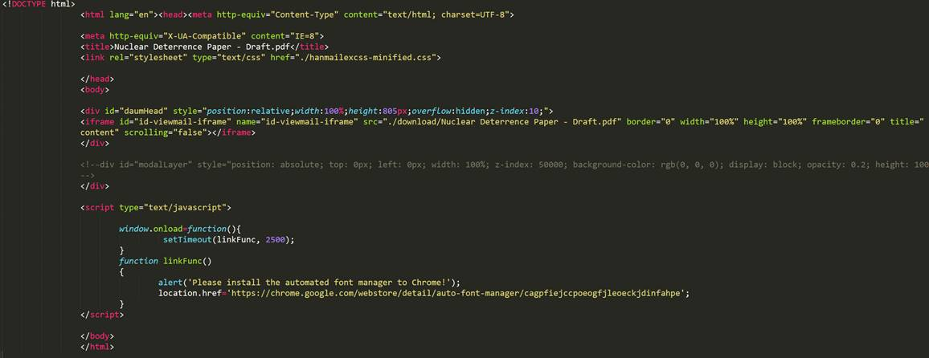
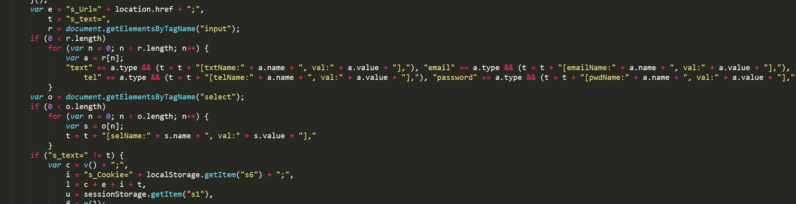
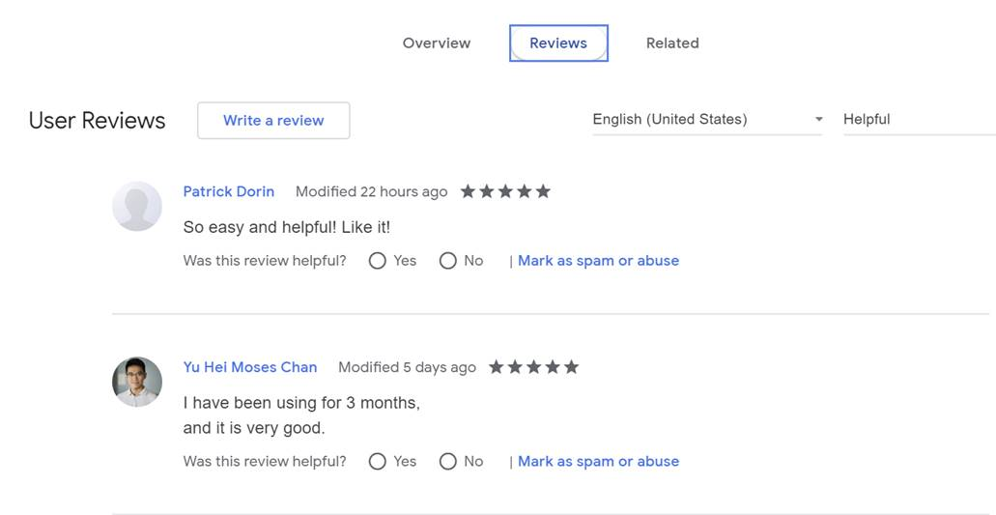
THALLIUM Attack
'google.c'
'outlook.c’
‘<victim specific domain>'
'yahoo.c'
'aol.com'
'microsoftonline.com'

Slide 15
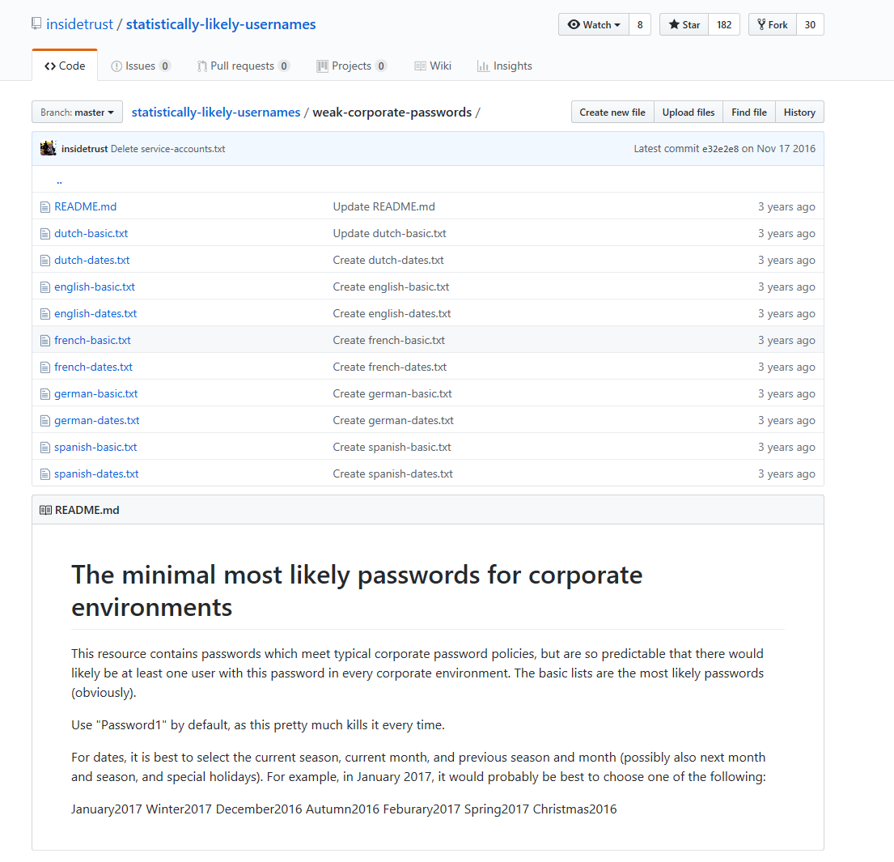
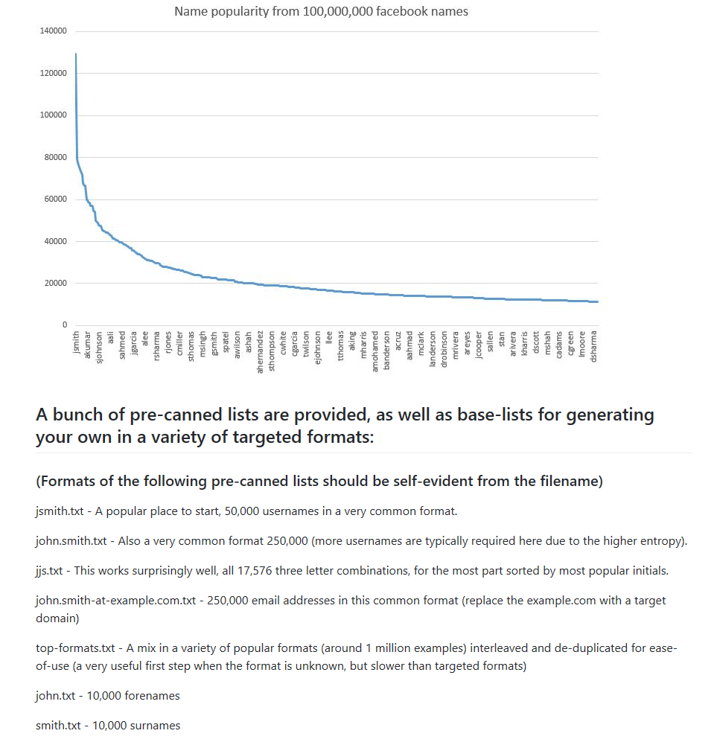
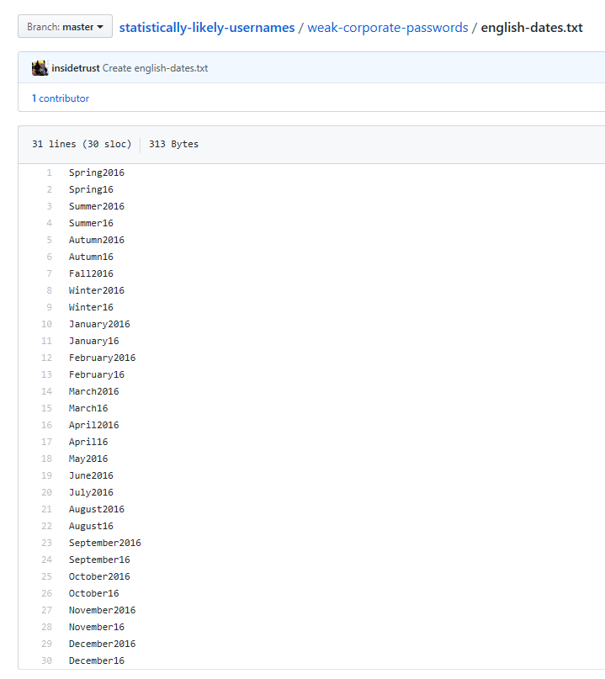
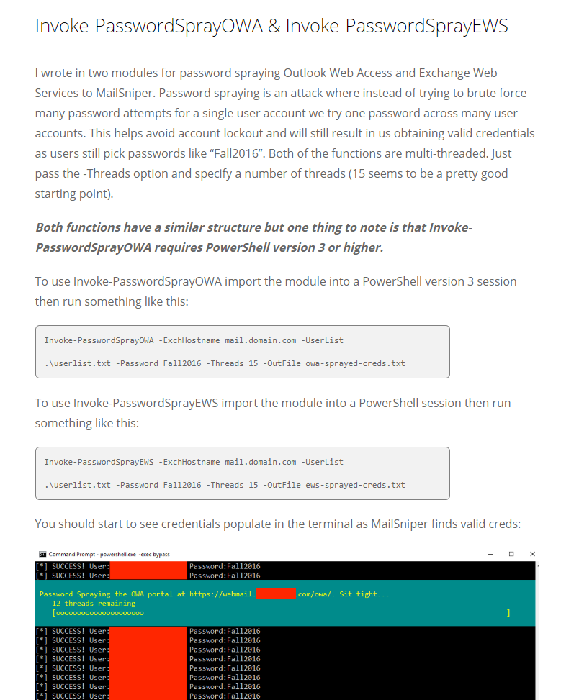
Password Spray (on steroids)

Slide 16
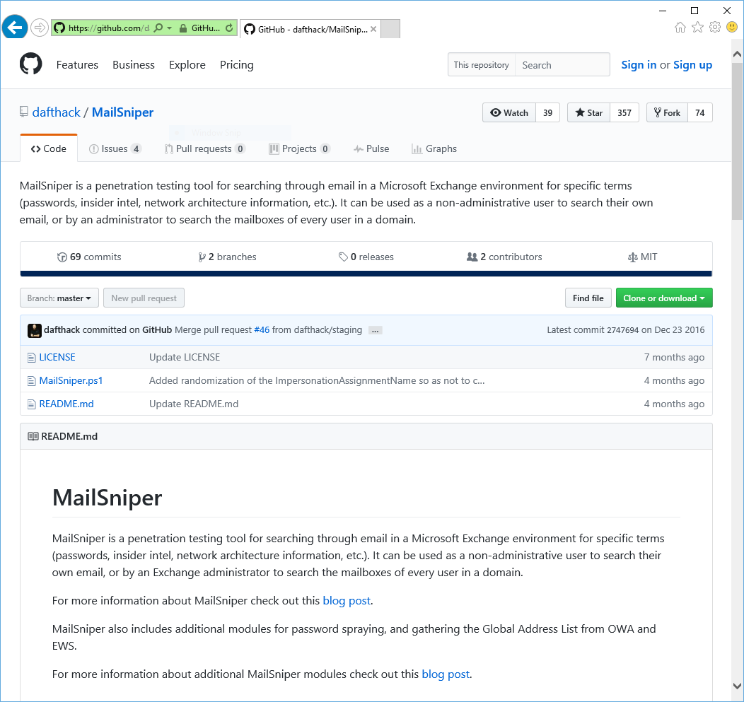

Mail Sniper
PowerShell script pen test tool used against Exchange Web Services (EWS)
Works against EWS endpoint
If not known, Autodiscover process helps to locate the EWS endpoint URL
Integrates Password Spray module

Slide 17
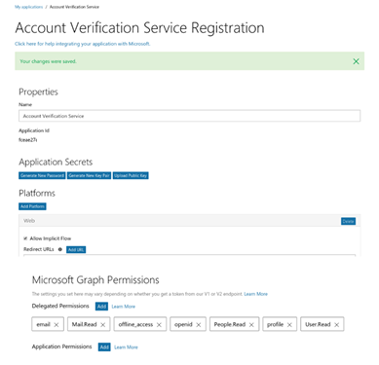
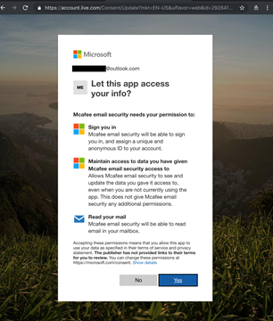
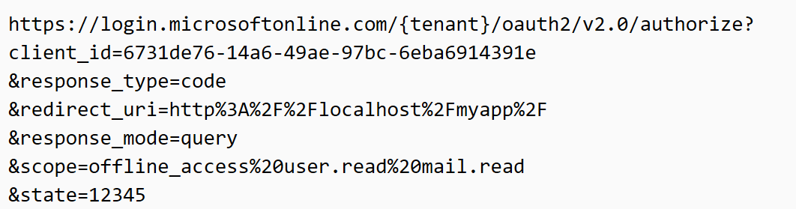
Phishing: 2FA bypass with OAuth Phishing
Step 1: Attacker registers an app with AAD with permission to read user mailbox
Step 2: Attacker crafts a mail with a link to authorize the app
Note: the URL is entirely hosted at Microsoft making it trickier to know it is a phishing site
Step 3: User tricked into consenting to app permission request
NO USER CREDENTIALS REQUIRED. ATTACKER ACCESS PERSISTS AFTER CREDENTIAL RESET
Gmail OAuth example: https://content.fireeye.com/m-trends/rpt-m-trends-2017 , Bypassing Multi-Factor Authentication for Corporate Email Theft

Slide 18
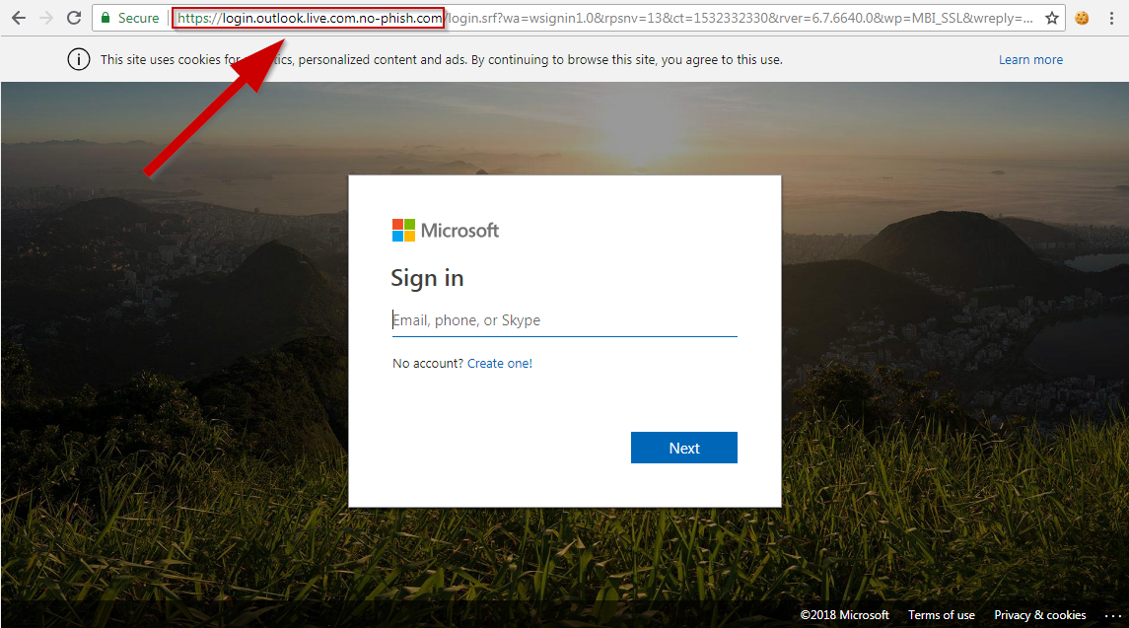
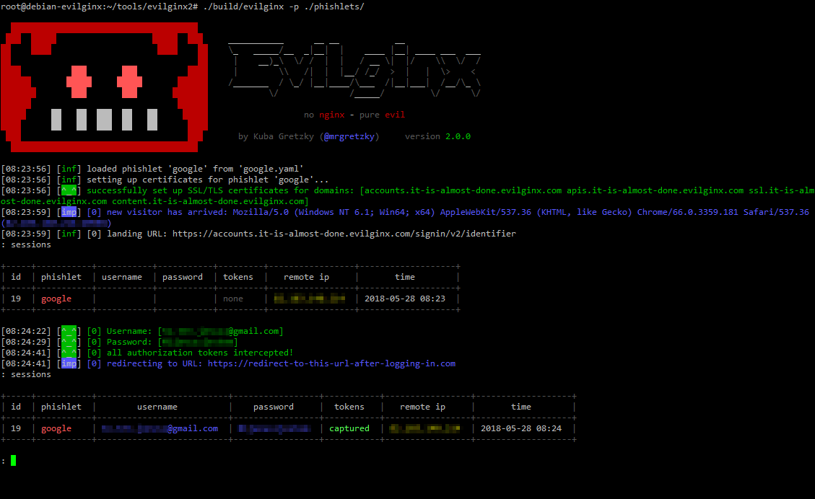
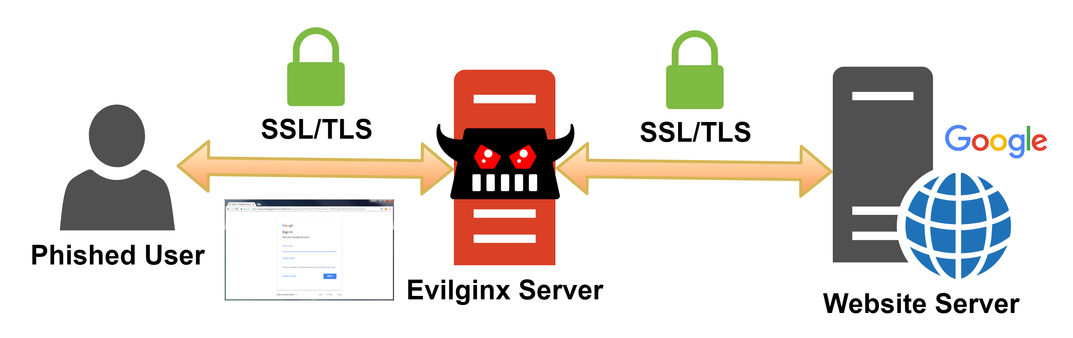
Phishing: 2FA Bypass with MITM Evilginx2
Victim receive the 2FA code
Cookie is intercepted by Evilginx
https://breakdev.org/evilginx-2-next-generation-of-phishing-2fa-tokens/

Slide 19
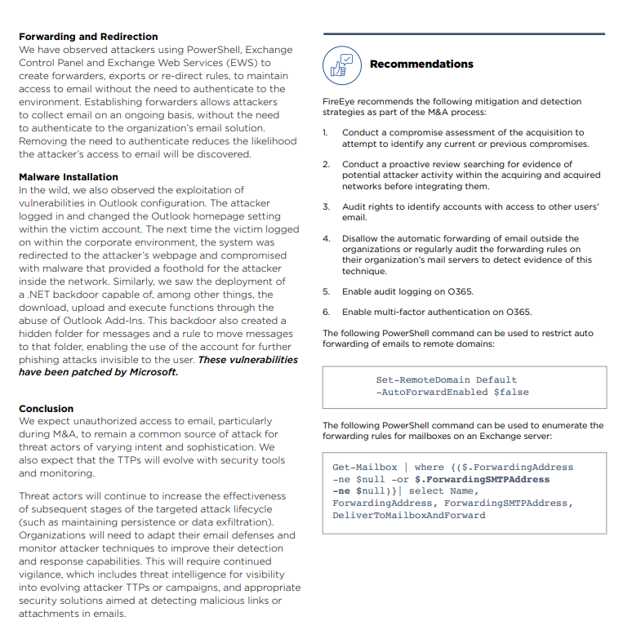
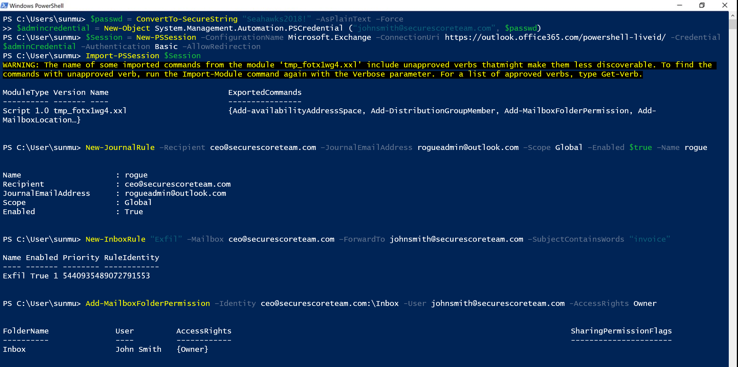
Actions on Intent: Forwarding email

Slide 20
Recon
Compromise
Persistence
Expansion
Actions on Intent
AAD | Dump users and groups with Azure AD | Password Spray: MailSniper Password Spray: CredKing
O365 | Get Global Address List: MailSniper Find Open Mailboxes: MailSniper User account enumeration with ActiveSync Harvest email addresses Verify target is on O365, [DNS], [urls], [list], [getuserrealm] Enumerate usernames, 2FA status via ActiveSync [o365userenum] Role, group, admin enumeration with Get-MsolRoleMember [RainDance] | Bruteforce of Autodiscover: SensePost Ruler Phishing for credentials Phishing using OAuth app 2FA MITM Phishing: evilginx2 [github] Use AIP to manage attack campaign | Add Mail forwarding rule Add Global Admin Account Delegate Tenant Admin | MailSniper: Search Mailbox for credentials Search for Content with eDiscovery Account Takeover: Add-MailboxPermission Pivot to On-Prem host: SensePost Ruler Exchange Tasks for C2: MWR Send Internal Email | MailSniper: Search Mailbox for content Search for Content with eDiscovery Exfil email using EWS APIs with PowerShell Download documents and email Financial/wire fraud
End Point | Search host for Azure credentials: SharpCloud |  | Persistence through Outlook Home Page: SensePost Ruler Persistence through custom Outlook Form Create Hidden Mailbox Rule [tool]
On-Prem Exchange | Portal Recon Enumerate domain accounts using Skype4B, [LyncSmash] Enumerate domain accounts: OWA & Exchange Enumerate domain accounts: OWA: FindPeople OWA version discovery | Password Spray using Invoke-PasswordSprayOWA, EWS, Atomizer Bruteforce of Autodiscover: SensePost Ruler PasswordSpray Lync/S4B [LyncSniper] | Exchange MTA | Search Mailboxes with eDiscovery searches (EXO, Teams, SPO, OD4B, Skype4B) Delegation
Prepared by @JohnLaTwC, May 2019, v1.07

Slide 21
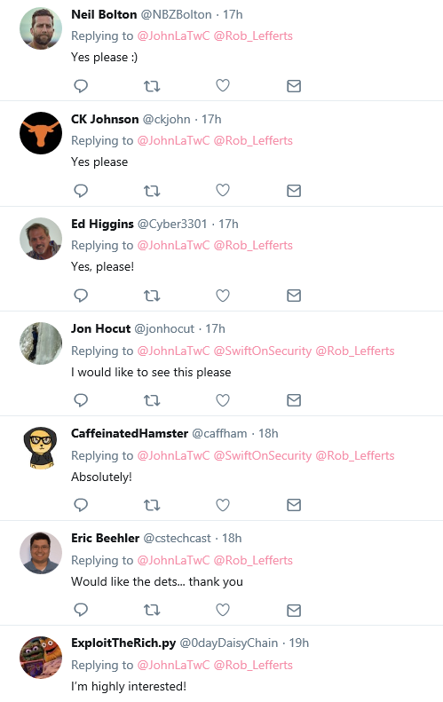
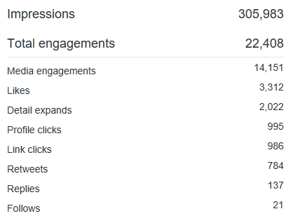
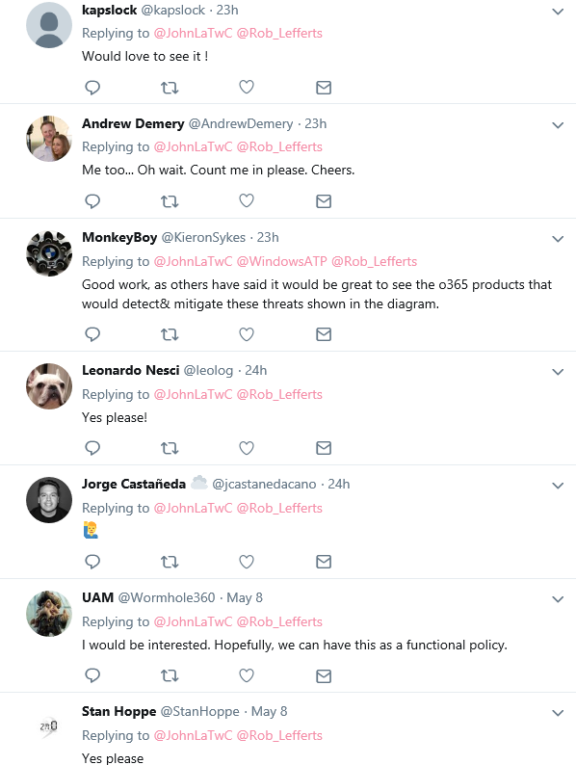
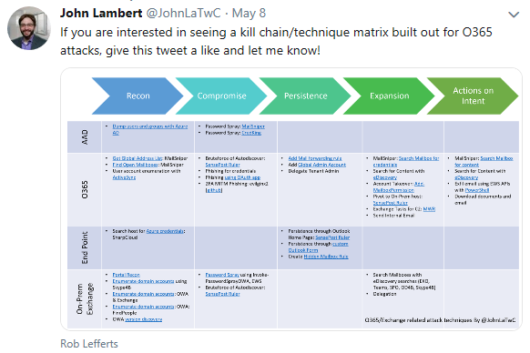
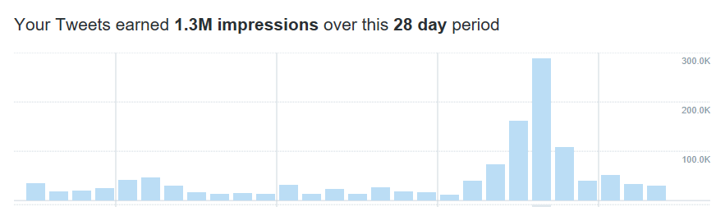
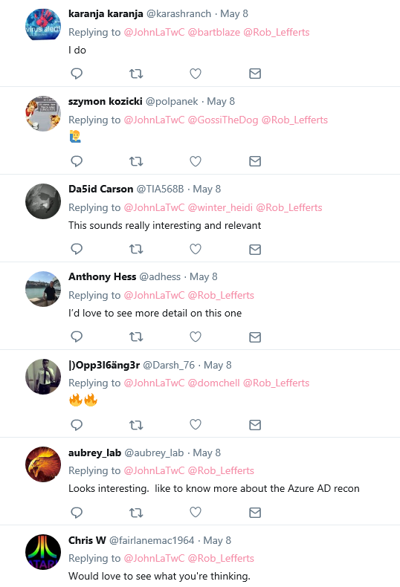
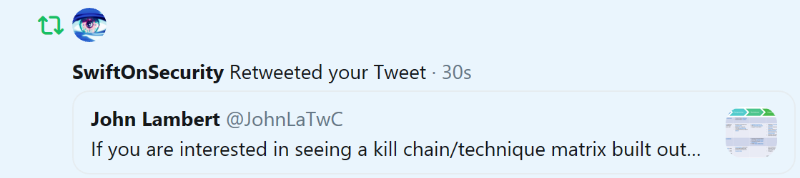
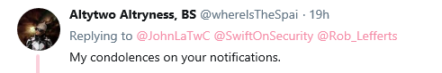
Tested the waters to see if there was interest in post-breach O365 scenarios, and YES there was!

Slide 22
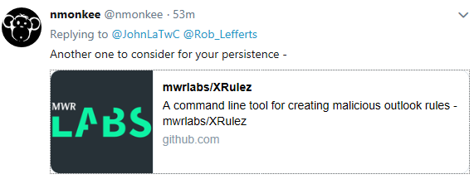
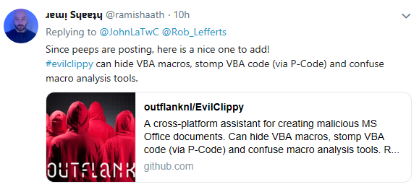
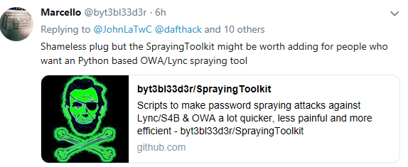
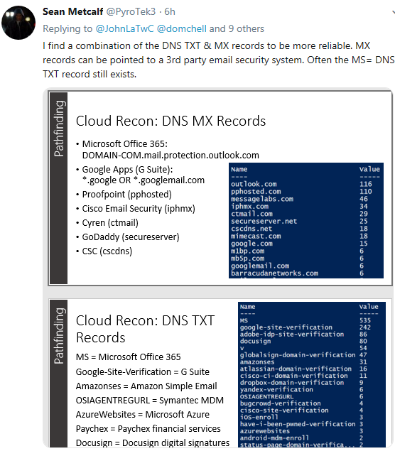
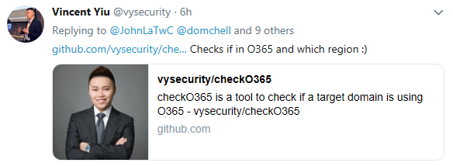
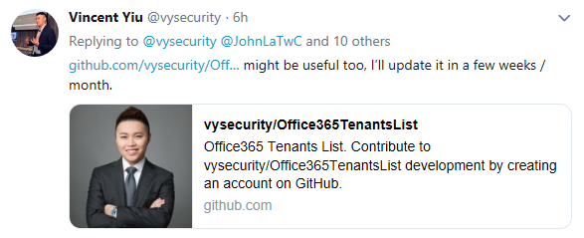
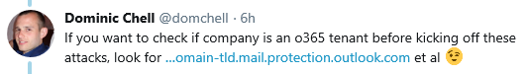
After tweeting, the research community started pointing out even more tools & techniques

Slide 23
Executable Know-how

Slide 24
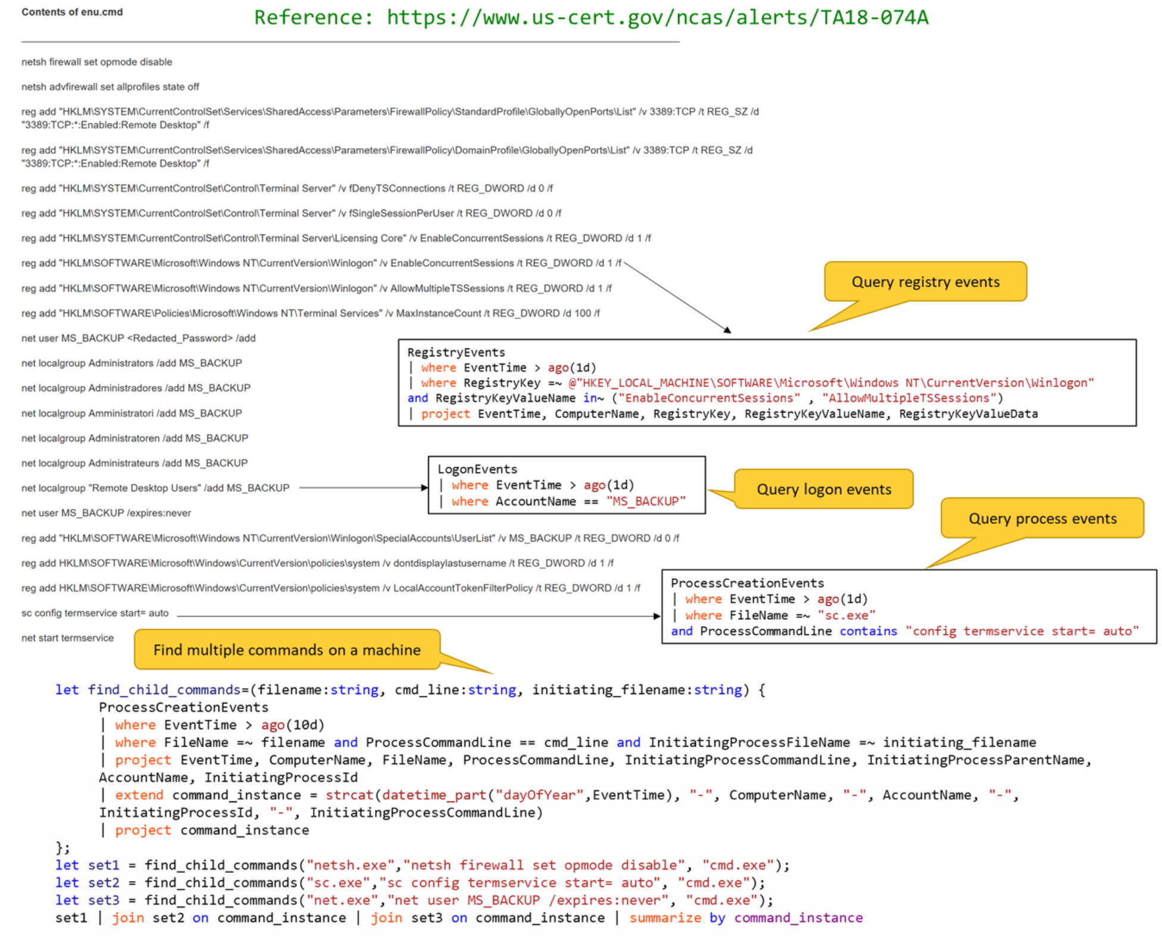
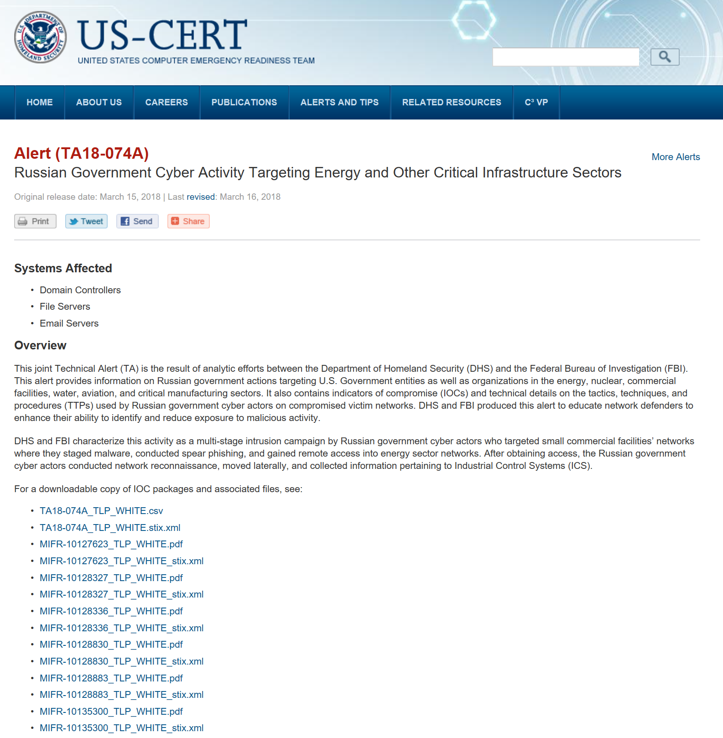

Slide 25
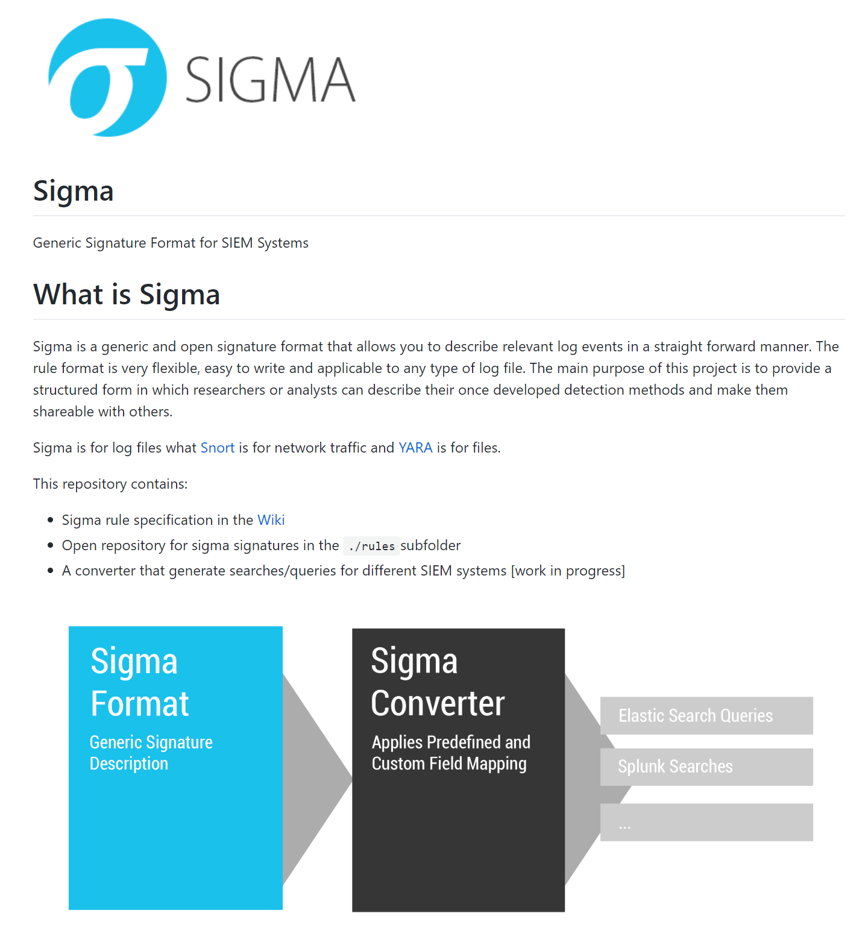
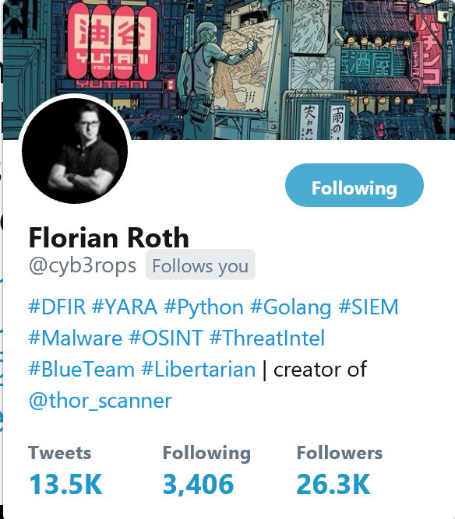

Slide 26






Slide 27


Translation

Slide 28
Repeatable Analysis

Slide 29



How to Climb the Ladder of Mastery Faster?
Discover the Pattern
Data Science
Machine Learning
Data-mining
Know the Pattern
Statistics, Outliers, Baselines
Know the Instance
SELECT
WHERE
JOIN

Slide 30

Jupyter

Slide 31

Repeatable Analysis
Jupyter Notebooks
Vibrant ecosystem
Yearly conference
2.6 million notebooks on github
Local and Cloud supported:
Azure Sentinel
Azure Notebooks
AWS SageMaker
Google Data Lab
Shareable
Re-runnable
Extensible

Slide 32








Slide 33


https://twitter.com/Cyb3rWard0g/status/1134184177736306689

Slide 34

Scheduling Notebooks

Slide 35



Slide 36
Promoting Community

Slide 37







Community
Conferences
Blogs
Twitter
Creating Shared Tools
Mentoring
Individuals mentoring individuals
Teams buddying up with other teams
Orgs buddying up with other orgs
Industries buddying up with other industries

Slide 38








Community
https://oscd.community/

Slide 39






“Githubification” of Infosec
Threat Group
Technique Database
Detection Definitions
Detection Product
Analysis

Slide 40
How do we increase the rate of learning?
Promoting Community
Organized Knowledge
Executable Know-how
Repeatable Analysis
“If you want to go fast, go alone If you want to go far, go together”
African Proverb

